Slide 1
WELCOME
By Aditya Garje,Raj Dalvi,
Utkarsh Barge,Alok Ahirrao
Guided By:-Mrs.Gauri Mathad
Project Based learning,
PES Modern College Of Engineering

Slide 2
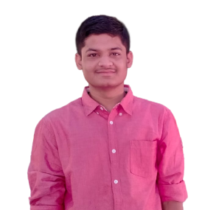
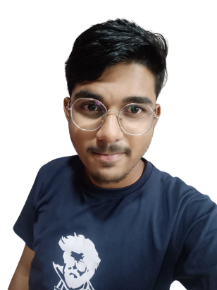
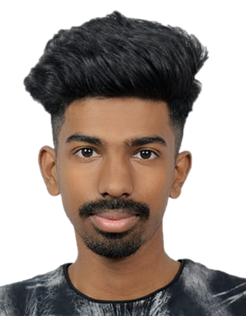
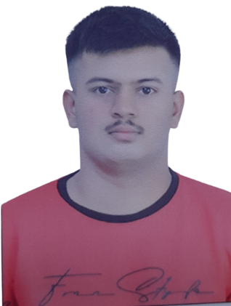
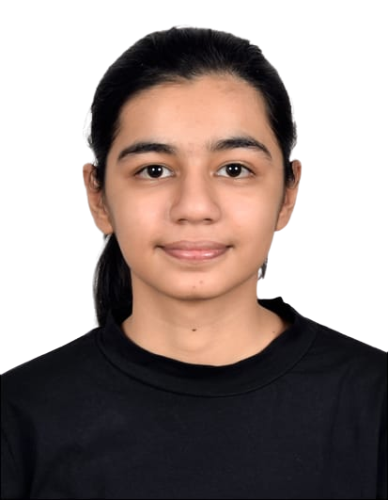
TEAM MEMBERS
01
03
04
05
02
Aditya Garje
Frontend and Backend Developer
Alok Ahirrao
Frontend and Backend Developer
Raj Dalvi
Frontend Developer
And analyst
Utkarsh Barge
Frontend Developer and analyst
Mitisha Chawala
Frontend Developer
And Backend Developer

Slide 3






Our Vision
Importance of Tourism
01
What are we going to achieve through tourism
02
Very Helpful as
city guide
03

Slide 4



What are we trying to achieve through tourism
Stimulates GDP growth
Increases the International trade
Boosts international Investment
Creates Job Efficiently
Promotes Inclusive Growth
Strengthens Rural Communities

Slide 5
OUR NEXT VISION
Term 1
Term 2
Term 3
Creating the basic guide of PUNE.
Creating the basic guide of MAHARASHTRA
Creating Basic Guide of INDIA

Slide 6




Languages Used for our project
1
2
3
4
HTML
CSS
JAVA
PHP

Slide 7
THANK YOU

